Slide 1

Branding isn’t just for Business:
The Importance of Self-Branding
Presented by Heidi Angell

Slide 2

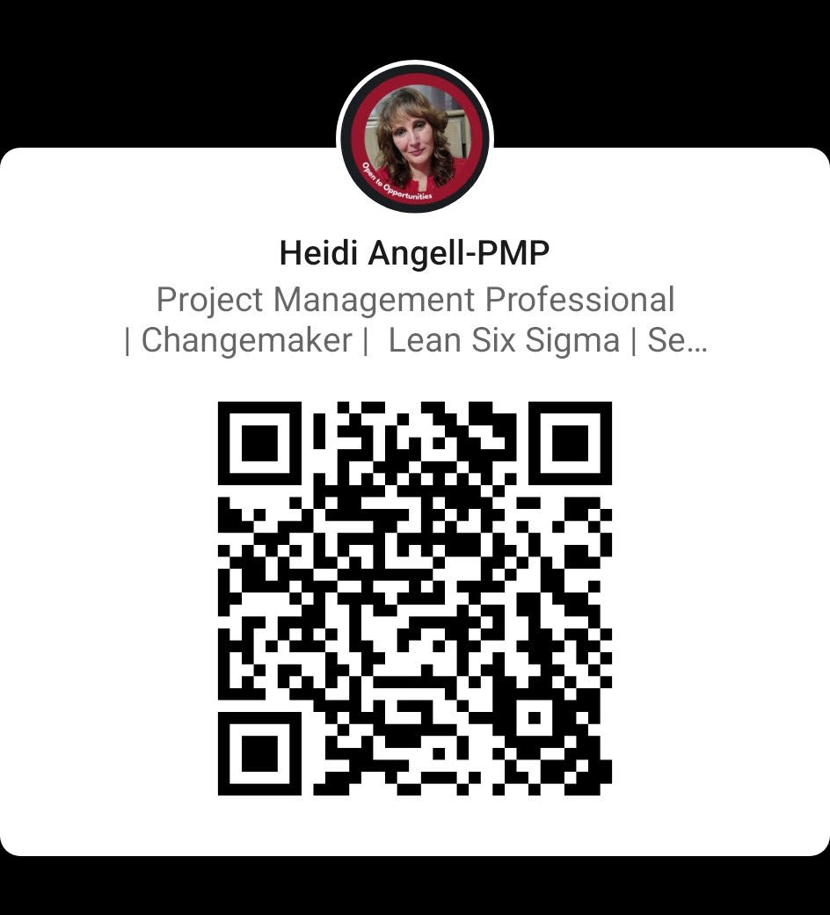
Heidi Angell
Heidi Angell has spent most of her career as a business consultant and contractor and knows firsthand the importance and necessity of personal branding. She shares over 20 years of wisdom and experience and distills it into actionable steps to help individuals and businesses grow.
Learn more at https://www.linkedin.com/in/heidi-angell/

Slide 3

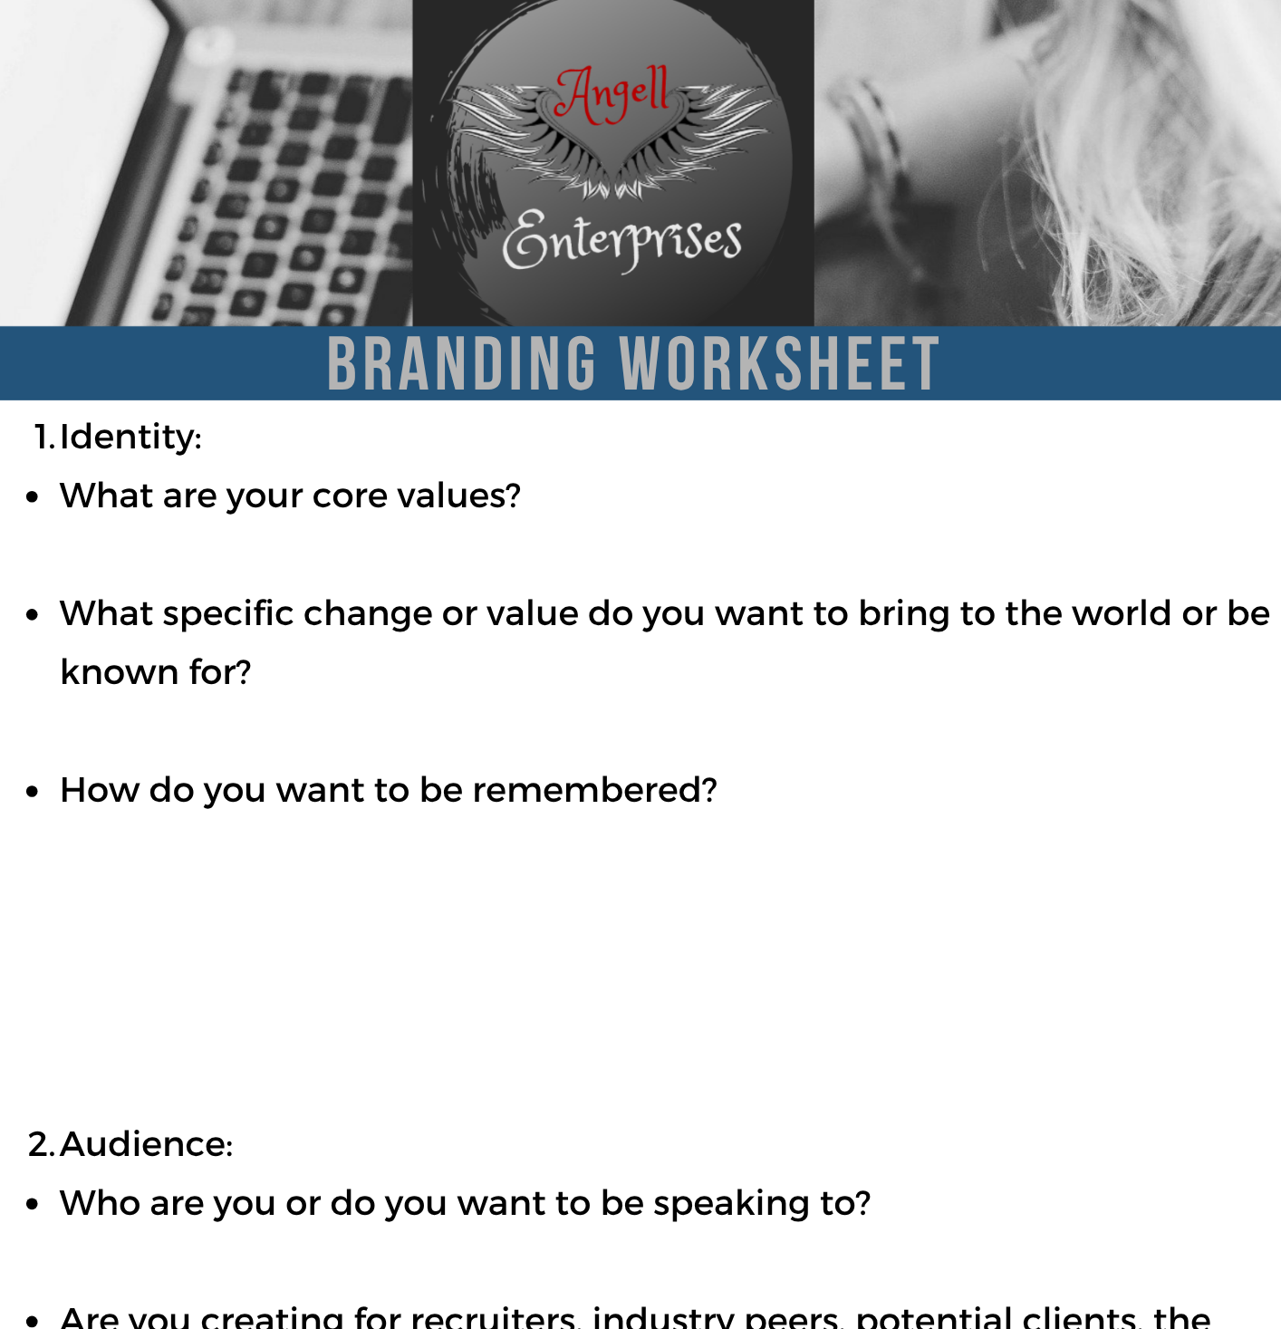
What is Branding?
Branding is the continuous process of creating a unique, recognizable identity for a business, product, or individual. It shapes how the public perceives and emotionally connects with a business, product, or individual.
What is Your Brand?
Go on a Listening Tour
Personal Branding Worksheet
Notes:
Ask Audience for examples of their brand.
For more on listening tours Check out Never Search Alone by Phil Terry
https://drive.google.com/file/d/12LxwzG2hHCOpR06cD7nNK0F0lirhNUqp/view?usp=sharing

Slide 4

How to Build Your Brand IRL (In Real Life)
Manage Up
Elevator Pitch
Networking
Consistency
Authenticity
Ask your direct supervisor for feedback.
Share career goals and ask for advice.
Bring concrete examples of how you would like to help.
30-60 second speech used to drive interest. Typically made up of 4 key elements:
The Hook: Start by identifying a specific problem or need.
The Solution: Explain exactly what you do to solve that problem.
The Value: Share the unique benefit, outcome, or result you bring to the table.
The Ask: End with a clear call to action.
Attend Events
Build on existing contacts
Network strategically
Taking the Work Out of Networking by Karen Wickre
Create a manageable pattern for your life.
Reflect on your Branding worksheet regularly.
Iterate listening to feedback on how you are perceived.
Make it real to who you are.
You can pick a side of yourself or you can present your whole self.
It is ok to have stretch goals as part of being authentic.
Notes:
Elevator Pitch: Hello, my name is Heidi Angell and I am a dream maker. I leverage my 20 years of consulting experience to help people and businesses grow and achieve their goals. Are you struggling to meet your goals? Let’s connect on Linkedin.

Slide 5

How to Build your Brand Online
ProjectManagement.com
LinkedIn
Google Alerts
Industry Specific sites
Substack
Attend Webinars
Contribute to Project Management Central
Build out Profile
Earn Badges
Provide recommendations
Update profile- Add projects
Interact regularly- posting and commenting
Write recommendations
Request recommendations
Host a B2B industry specific newsletter
Join relevant Linkedin Groups and comment often.
Setting up Google Alerts is Easy.
Go to https://www.google.com/alerts
Choose keywords
Choose frequency
Join other Associations
Find their platforms
Create profiles
Schedule a frequency of showing up.
Create your own channel
Select paid and free content
Set a schedule
Keep your schedule.

Slide 6

Questions and Answers

