Slide 1


March 2026
The Talent Gap & Future of Project Leadership
Launching PMI Arizona Thought Leadership

Slide 2
Session Guidelines
Helping us create a smooth and engaging experience for everyone
Please keep your camera on if possible
Stay muted during the session
Minimize background distractions
Use the chat for comments and questions
Our moderator will support engagement
Q&A at the end of the session

Slide 3
PMI Arizona Thought Leadership
Bringing PMI research into practice for our community
PMI Arizona Thought Leadership
Launching our inaugural series
Bringing PMI research into practice
Mix of virtual and in-person sessions
PDUs available for each session
Led By
Katie Lux – Executive Sponsor
Widline Luctama – Program Director
Veronika Fish – Event Project Manager
Supported by PMI Arizona teams
Get Involved
We’re looking for speakers
Full support provided for preparation
We’re looking for volunteers
Visit PMIAZ.org or connect via our social channels
***Feedback: Survey link will be shared in the chat.***

Slide 4
Session Agenda
Launching PMI Arizona Thought Leadership
Executive Overview
Scale of the Global Talent Gap
Geographic Distribution of Demand
Structural Demand Drivers
Workforce Development Imperatives
Strategic Risk and Opportunity

Slide 5
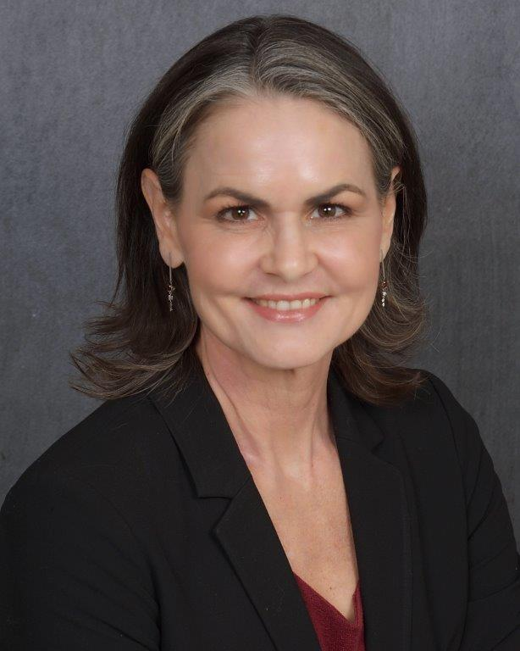
Meet Our Speaker
Stephanie Hanko, M.A., PMP
CSG Government Solutions, Inc.
(Ranked by Forbes as One of America’s Best Management Consulting Firms from 2018-2026)

Slide 6
Executive Overview
Demand Acceleration, Structural Shortfall, and System-Level Risk
Global demand for project professionals* is accelerating.
By 2035, demand may reach 65 million professionals globally.
Estimated talent shortfall: up to 30 million.
The gap represents:
  A systemic workforce risk
  A strategic transformation opportunity
* PMI looked at 172 job titles related to project professionals (includes project, program and portfolio managers, Agile professionals, product managers and product owners).

Slide 7
“
By 2035, organizations could need up to 65 million project professionals to keep
pace with growth and change.”
Global Project Management Talent Gap Report

Slide 8
Scale of the Global Talent Gap
Quantifying the Workforce Deficit and Its Expected Consequences
~40 million project professionals globally in 2025.
Projected demand growth driven by structural economic shifts.
Shortfall magnitude suggests:
    Insufficient workforce pipeline
    Misalignment between skills supply and market demand
Implications:
    Delayed capital projects
    Increased labor costs
    Strategic execution risk

Slide 9
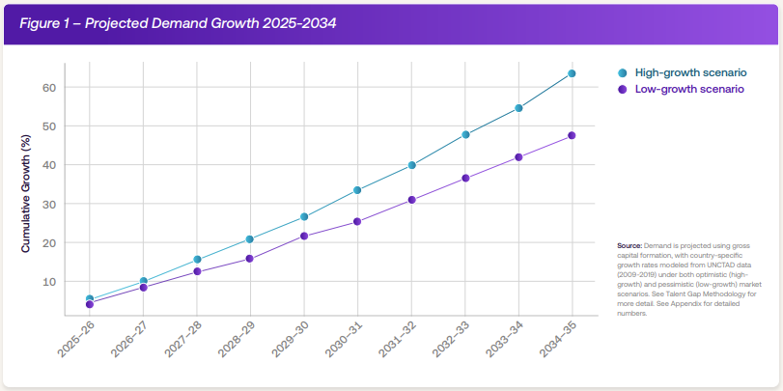
Demand for Project Professionals
Growth Trends

Slide 10
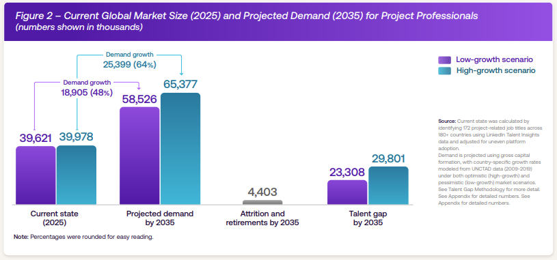
Project Professional Demand Growth
Global Market Size Trends

Slide 11
Geographic Distribution of Demand
Emerging Economies as Primary Growth Engines
Highest projected growth regions:
South Asia
Sub-Saharan Africa
China
Characteristics:
Rapid industrialization
Infrastructure expansion
Digital acceleration

Slide 12
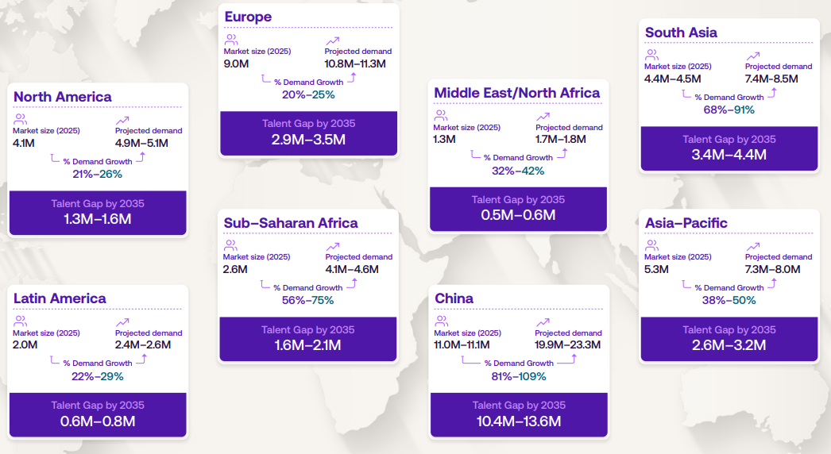
Talent Gap by Region
Market Size Change

Slide 13
Industry-Specific Demand Pressures
Drivers of Project Demand Across Key Industries
High-growth sectors:
Construction
Manufacturing
Information Technology
Healthcare
Drivers:
Infrastructure modernization
Digital transformation
Industrial automation
Health system scaling
Project management capacity is becoming a cross-sector critical competency.

Slide 14

Mature Economy Dynamics
Reskilling Imperatives in Slower-Growth Labor Markets
Slower net workforce growth
Aging professional base
Increased need for:
    Reskilling
    Digital competency development
    Process modernization
The issue is not only headcount — it is capability transformation.

Slide 15
Workforce Development Imperatives
Defining the Solution
Closing the gap requires shifts from recruitment to sustainable talent pipelines:
Invest in education and training
Remove barriers and expand access to career pathways
Support continuous learning and specialization

Slide 16
Strategic Risk and Opportunity
From Execution Bottleneck to Competitive Advantage
Risk Dimension:
Execution bottlenecks
Reduced organizational agility
Economic growth constraints
Opportunity Dimension:
Elevate project management as a strategic career pathway
Institutionalize project capability as a competitive differentiator
Strengthen organizational resilience

Slide 17
PMI’s Strategic Role
Institutional Support for Professionalization and Capability Scaling
PMI contributes through:
Structured learning resources
Global credentialing standards
Professional networks
Advocacy for the profession
Community of project professionals
Positioning project management as foundational to transformation and resilience.

Slide 18
PMI Arizona Chapter’s Role in Developing Project Talent
Thought Leadership sessions grounded in PMI research
Learning opportunities across career stages
Partnerships with ASU and academic institutions
Statewide access through virtual programming
Community, networking, and mentorship

Slide 19
Wrap Up
Key Takeaways
Project professional demand is increasing
Economic change, technological change, infrastructure/capital investment driving demand
Project professionals key in organizational resilience and transformation
Mature economies have aging project professional populations
Education/training, professional development, career pathways and guidance are needed
PMI and local chapters poised to support project professional workforce

Slide 20

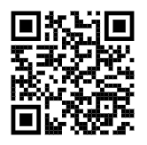
Next Steps & Stay Connected
Let Us Know!
Would you like to be a Thought Leadership Speaker?
Scan or Click
Thought Leadership Speaker Interest Form – Fill out form
How did we do?
Please fill out the Post-Event Speaker Survey
Scan or Click
Post-Event Feedback Survey: PMI Arizona Thought Leadership: The Talent Gap & Future of Project Leadership

Slide 21
Thank You!
PDU Code: 8030FCQLQ0

Slide 22
Source
Project Management Institute. (2025, April). Global project management talent gap [Report]. https://www.pmi.org/learning/thought-leadership/global-project-management-talent-gap
PMI Global Thought Leadership Web Page
https://www.pmi.org/learning/thought-leadership

